Slide 1
What is Spring Boot and why is everyone using it?

Slide 2
Training Agenda
Enterprise applications with Spring
W1: Enterprise applications - starting toolbox
W2: How Spring can improve your life as a programmer
W3: Dive into the Web
W4: What is Spring Boot and why is everyone using it?
W5: Improve your application robustness with testing and API documentation

Slide 3
W4 Timeline
Spring Boot overview and starters
Spring Boot overview and main features
Create a Spring Boot project
Spring Boot Starters
Demo and configuring Spring Boot
Demo - From Spring to Spring Boot
Configuring Spring Boot
Deployment and actuators
More on deploying Spring Boot apps
Spring Boot Actuators
Lab exercises
Time to put in practice what you’ve just learned

Slide 4
Spring Boot overview & main features

Slide 5
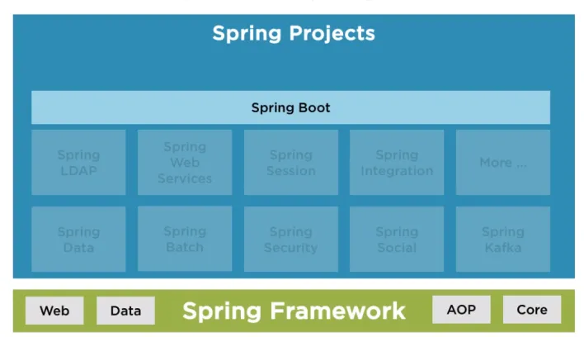
Spring Boot overview & main features
High level overview
Spring Boot

Slide 6
Spring Boot overview & main features
High level overview
Spring Boot
Quick and easy development
Build web and non-web apps
Auto-configuration
Standalone
Opinionated

Slide 7
Spring Boot overview & main features
Auto-configuration
Spring Boot Auto-configuration
Tries to automatically configure the application based on which dependencies you have added.
Makes use of context to best guess how an application should be set up.

Slide 8


Spring Boot overview & main features
Auto-configuration
Spring Boot Auto-configuration

Slide 9
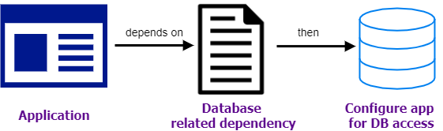
Spring Boot overview & main features
Auto-configuration
Spring Boot Auto-configuration

Slide 10
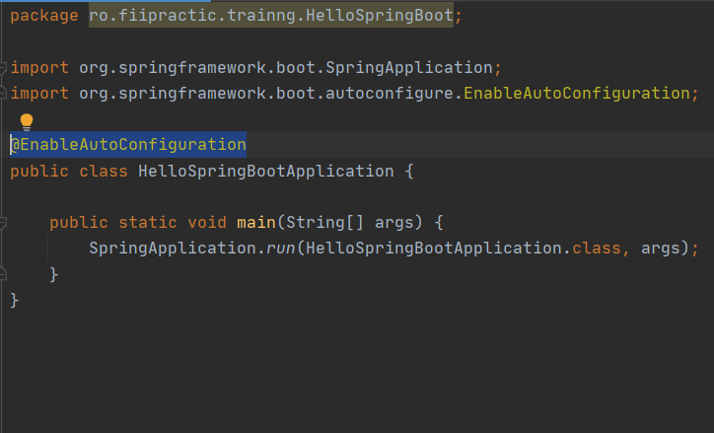
Spring Boot overview & main features
Auto-configuration
Spring Boot Auto-configuration

Slide 11
Spring Boot overview & main features
Standalone
Running a
Java Web App
Do you remember the steps needed for running a Java web app?

Slide 12
Spring Boot overview & main features
Standalone
Running a
Java Web App
Package application
Choose Web server
Download Web server
Configure Web server
Deploy application (copy .war file into webapps - for Tomcat)
Start Web server

Slide 13
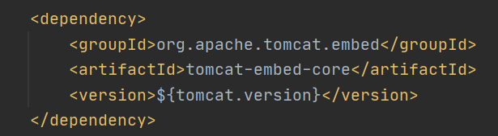
Spring Boot overview & main features
Standalone
Embedded
Tomcat

Slide 14
Spring Boot overview & main features
Standalone
Running a
Spring Boot Web App
Package application
Run application:
java -jar HelloWeb.jar

Slide 15
Spring Boot overview & main features
Opinionated
What it means an opinionated view of building Spring based apps?
Convention over configuration
Helps with libraries, tooling and config choices
Easy to override predefined choices
Spring Boot
Opinionated

Slide 16
Create a Spring Boot project

Slide 17
Create a Spring Boot project
Ways to create a
Spring Boot app
Spring Initializr
IDE (licensed version)
Spring Boot CLI

Slide 18
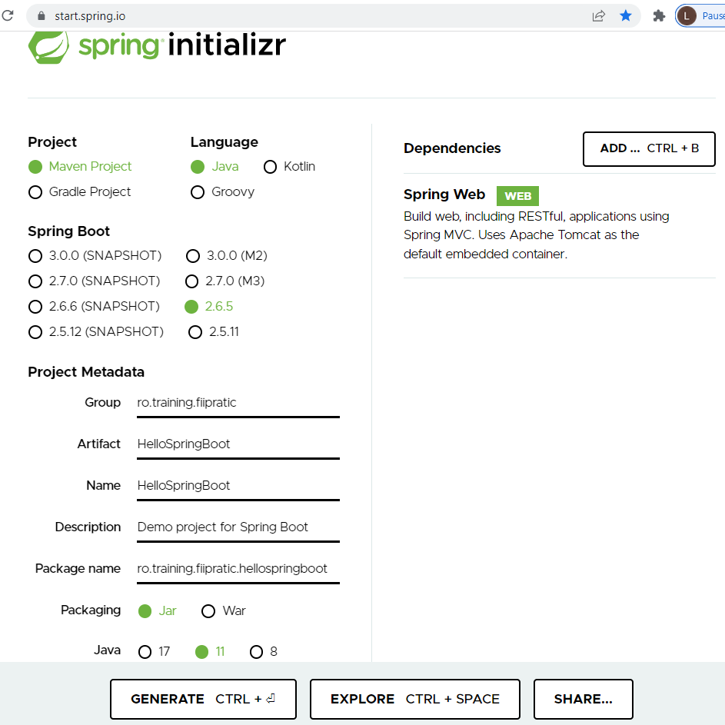
Create a Spring Boot project
Spring Initializr
Spring Initializr

Slide 19
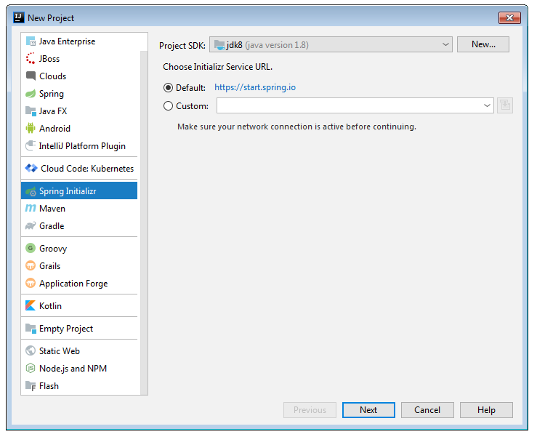
Create a Spring Boot project
IDE (licensed version)
IntelliJ IDEA
(licensed version)

Slide 20
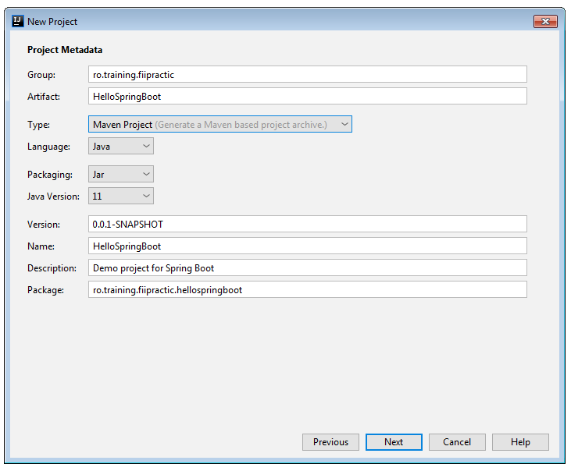
Create a Spring Boot project
IDE (licensed version)
IntelliJ IDEA
(licensed version)

Slide 21
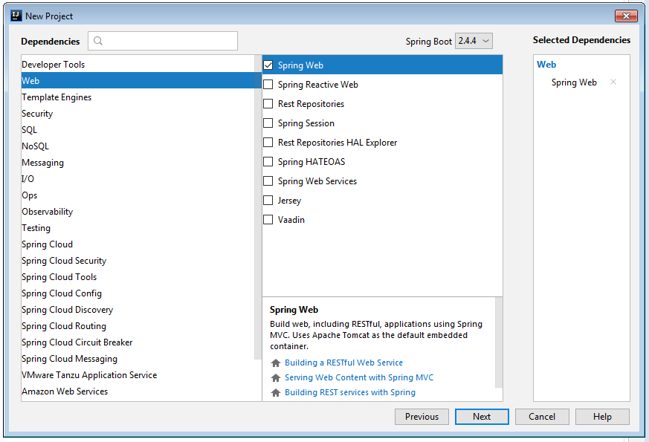
Create a Spring Boot project
IDE (licensed version)
IntelliJ IDEA
(licensed version)

Slide 22
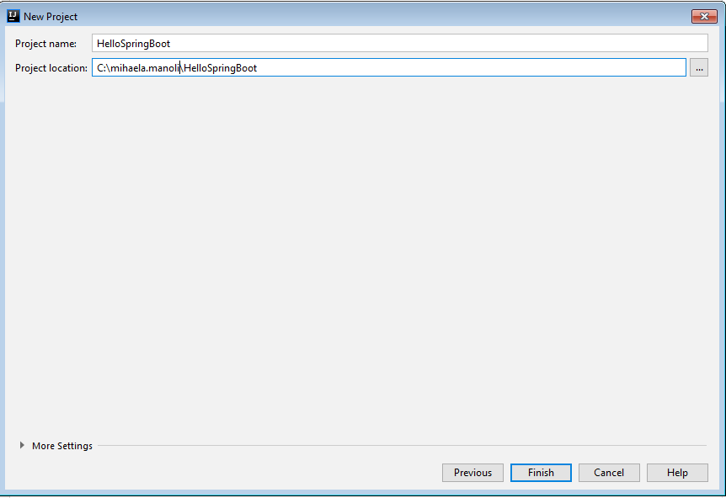
Create a Spring Boot project
IDE (licensed version)
IntelliJ IDEA
(licensed version)

Slide 23
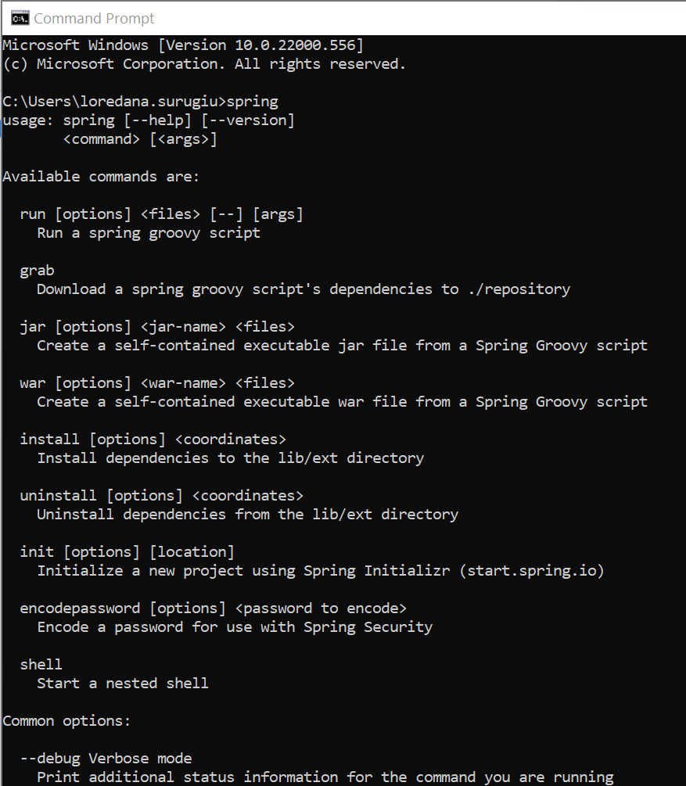
Create a Spring Boot project
Spring Boot CLI
Install
Spring Boot CLI
spring
spring init --list
spring help init

Slide 24
Spring Boot Starters

Slide 25
Spring Boot Starters
Spring Boot Starters
Starter - a way to integrate dependencies on the project by simply declaring them.
Spring Boot apps specify what pieces of Spring framework will use.
All dependencies specified in pom.xml.

Slide 26
Spring Boot Starters
Spring Boot Starters
spring-boot-starter
spring-boot-starter-web
spring-boot-starter-test

Slide 27
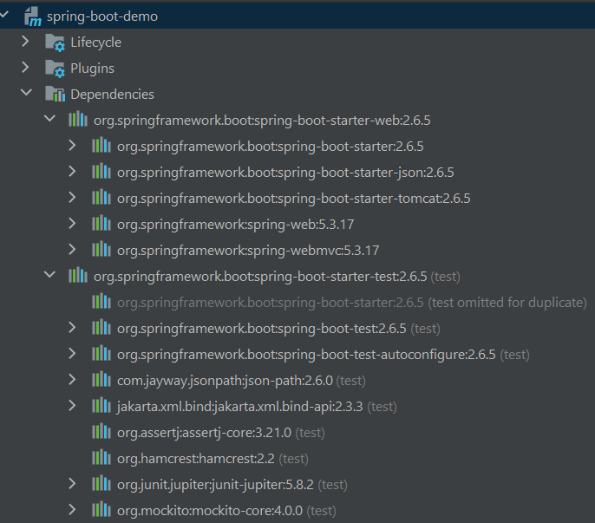
Spring Boot Starters
Spring Boot Starters

Slide 28
Demo Spring Boot
From Spring to Spring Boot

Slide 29
Demo Spring Boot
From Spring to Spring Boot
Migrate SpringRestAPI (Session 3) to Spring Boot
Create new Spring Boot Project using Spring CLI:
spring init --groupId=ro.info.iasi.fiipractic --artifactId=spring-boot-rest-api --packaging=jar --package-name=ro.info.iasi.fiipractic --name=SpringBootRestAPI --dependencies=web spring-boot-rest-api.zip
Copy all packages from SpringRestAPI under ro.info.iasi.fiipractic to SpringBootRestAPI under the root with same name
Notes:
- timeboxed 15 mins

Slide 30
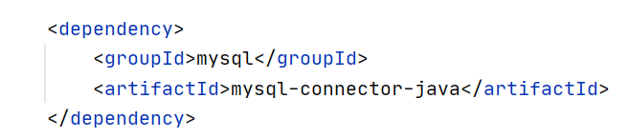
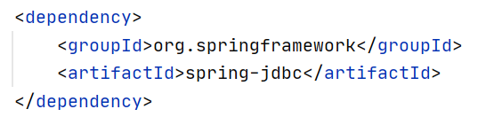
Demo Spring Boot
From Spring to Spring Boot
3. Solve dependencies:
Add MySQL
Dependency
Add Spring Jdbc
dependency
Notes:
- timeboxed 15 mins

Slide 31
Demo Spring Boot
From Spring to Spring Boot
4. Remove FontControllerConfig.class
No need to config Dispatcher Servlet anymore
5. Copy database properties
from MVC application to Spring Boot application
6. Rename application.properties to db-application.properties
OR
Remove @PropertySource("classpath:db-application.properties")
defined in AppConfig.class
Notes:
- timeboxed 15 mins

Slide 32
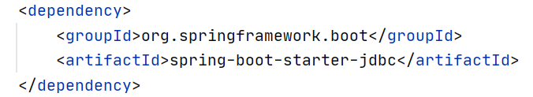
Demo Spring Boot
From Spring to Spring Boot
At this point our application is ready to run. But, as we are using Spring Boot, we can take more advantage of its features:
7. Remove @EnableWebMvc and @ComponentScan
(@SpringBootApplication will take care of it)
8. Use JDBC Starter: remove @Configuration or delete AppConfig.class and replace spring-jdbc with spring-boot-starter-jdbc dependency pom.xml:
Notes:
- timeboxed 15 mins

Slide 33
Configuring Spring Boot

Slide 34


Configuring Spring Boot
Configuration sources
Internal sources
Property files
Java configuration
Servlet parameters
External sources
Command line args
JNDI
OS environment vars
Notes:
Internal: - fisiere de proprietati
Suprascriere de clase din spring care sunt deja configurate
NEXT: lista de prioritati

Slide 35
Configuring Spring Boot
Order of precedence
Command line args
SPRING_APPLICATION_JSON args
Servlet parameters
JNDI
Java System Properties
OS environment variables
Profile properties
Application properties
@PropertySource annotations
Default properties
Notes:
Exemplu user si linia de comanda/app props / default props
Profile vs Application
Next : toate proprietatile springului

Slide 36
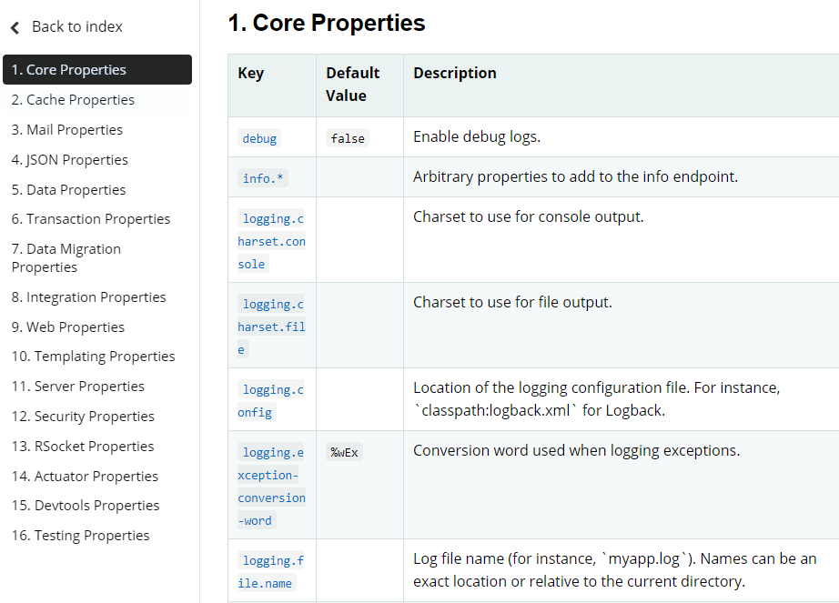
Configuring Spring Boot
What properties can
you configure/override?
Common Application properties
Notes:
Link catre toate props
Puteti configura toate dependintele aduse automat de spring web
Server.port
NEXT: profile

Slide 37
Configuring Spring Boot
Environment configuration
application-{profile}.properties
application-dev.properties
application-prod.properties
-Dspring.profiles.active=prod
Notes:
-D parameter : https://stackoverflow.com/questions/44745261/why-do-jvm-arguments-start-with-d
Exemplu : props file
NEXT: properties vs yml

Slide 38
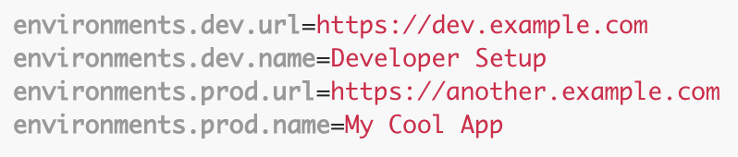
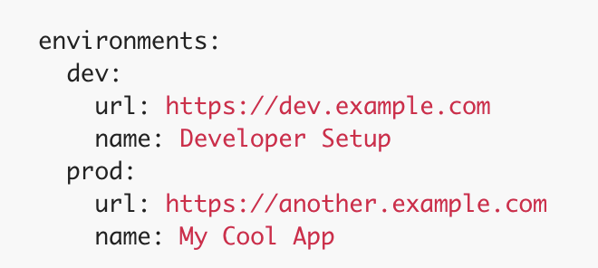
Configuring Spring Boot
Yml vs
property files?
application.properties
application.yml
Notes:
Facem yaml si lasam si props sa vedem care e default

Slide 39
More on Deploying Spring Boot Apps

Slide 40



More on Deploying Spring Boot Apps
Embedded containers
in Spring Boot
Default container:
Supported containers:

Slide 41
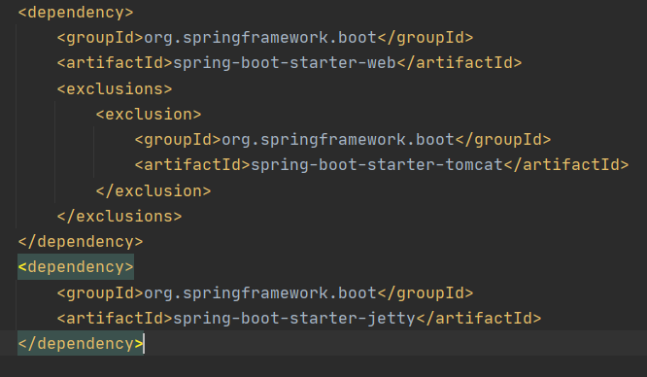
More on Deploying Spring Boot Apps
Embedded containers
in Spring Boot
Demo: switch from Tomcat to Jetty
Notes:
Dependenta de jetty -> de ce nu porneste jetty?
Stergem tomcat din web
Pornim dupa fara niciun container
Next : actuator PAUZA???

Slide 42
Spring Boot Actuators

Slide 43
Spring Boot Actuators
Overview
Spring Boot
Actuators
Actuator - used to expose operational information about the running application: health, metrics, info, env, beans...
Use HTTP endpoints or JMX beans to enable us to interact with it.
Once the dependency is added, several endpoints are available.
Notes:
Next: dependinta

Slide 44
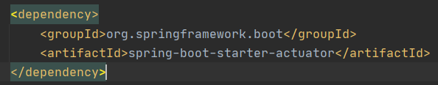
Spring Boot Actuators
Examples
Spring Boot
Actuators
Actuator comes with the majority of the endpoints disabled. Only /health is enabled by default.
To enable /info props:
management.info.env.enabled=true
To enable all of them:
management.endpoints.web.exposure.include=*
Notes:
EXEMPLU :D

Slide 45
Lab exercises
Migrate what you have done until now using Spring to Spring Boot
OR
Continue working on the project using Spring

Slide 46
Thank You!

